Slide 1

6 Yaml Introduction
Peter H. Chen

Slide 2

6 Yaml Introduction
https://www.youtube.com/watch?v=o9pT9cWzbnI&list=PL2We04F3Y_43dAehLMT5GxJhtk3mJtkl5&index=6
What is Yaml?
We discuss what Yaml files are.
The entire Kubernetes setup depends entirely on Yaml.

Slide 3
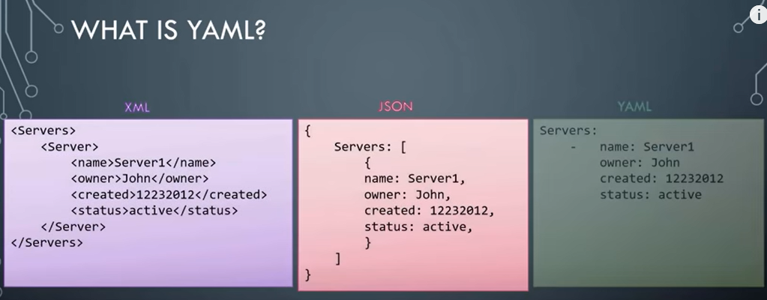
6 Yaml Introduction
https://www.youtube.com/watch?v=o9pT9cWzbnI&list=PL2We04F3Y_43dAehLMT5GxJhtk3mJtkl5&index=6
What is Yaml? (0:40/8:25)
Yaml format is very similar to XML or JSON.
Yaml file format is very easy to pickup.

Slide 4
6 Yaml Introduction
https://www.youtube.com/watch?v=o9pT9cWzbnI&list=PL2We04F3Y_43dAehLMT5GxJhtk3mJtkl5&index=6
What is Yaml? (0:57/8:25)
Below is the sample data for three different formats.
The one on the left is XML where we display a list of servers and their information.
The same data is represented in JSON format in the middle.
…and Yaml format to the right.

Slide 5
6 Yaml Introduction
https://www.youtube.com/watch?v=o9pT9cWzbnI&list=PL2We04F3Y_43dAehLMT5GxJhtk3mJtkl5&index=6
What is Yaml? (1:09/8:25)
Take a minute to compare three formats.

Slide 6
6.1 Yaml Key-Value

Slide 7
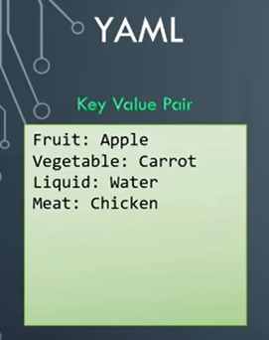
6.1 Yaml Key-Value
https://www.youtube.com/watch?v=o9pT9cWzbnI&list=PL2We04F3Y_43dAehLMT5GxJhtk3mJtkl5&index=6
Yaml Key-Value (1:23/8:25)
Let’s look at a close look at Yaml if you take the data in its simplest form, such as, key-value pair.
This is how you would define in Yaml key and value separated by a colon (:).
The keys are Fruit, Vegetable, Liquid, and Meat.
.. And the values are Apple, Carrot, Water, and Chicken.

Slide 8
6.2 Yaml Array

Slide 9
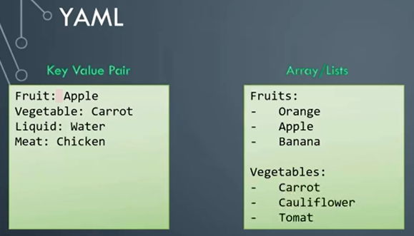
6.2 Yaml Array
https://www.youtube.com/watch?v=o9pT9cWzbnI&list=PL2We04F3Y_43dAehLMT5GxJhtk3mJtkl5&index=6
Yaml Array (1:47/8:25)
Remember, we must have a space followed by colon (:) differentiating the key and the value.
Let’s take a look at how an array is represented.
If we would like to list some fruits and vegetables, we would say, fruits followed by a colon (:). On the next line, enter each item with a dash (-) in the front.
The dash (-) indicates that it is an element of an array.

Slide 10
6.3 Yaml Dictionary

Slide 11
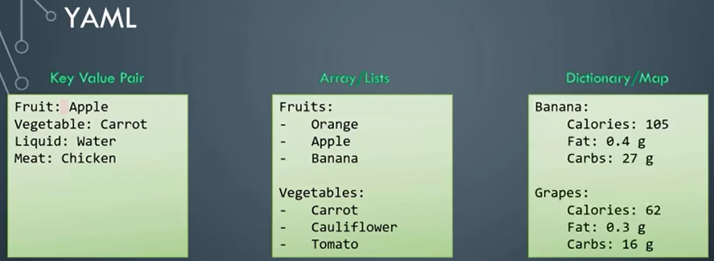
6.3 Yaml Dictionary
https://www.youtube.com/watch?v=o9pT9cWzbnI&list=PL2We04F3Y_43dAehLMT5GxJhtk3mJtkl5&index=6
Yaml Dictionary (2:12/8:25)
How about the dictionary?
A dictionary is a group of properties grouped together under an item.
Here, we try to represent nutrition information of two fruits: the Calories, Fat, and Carbs, are different for each fruit.

Slide 12
6.3 Yaml Dictionary
https://www.youtube.com/watch?v=o9pT9cWzbnI&list=PL2We04F3Y_43dAehLMT5GxJhtk3mJtkl5&index=6
Yaml Dictionary (2:35/8:25)
Notice the blank space before each item.
We must have equal number of blank spaces before the properties of a single item.
So, they are all aligned together.

Slide 13
6.4 Yaml Spaces

Slide 14
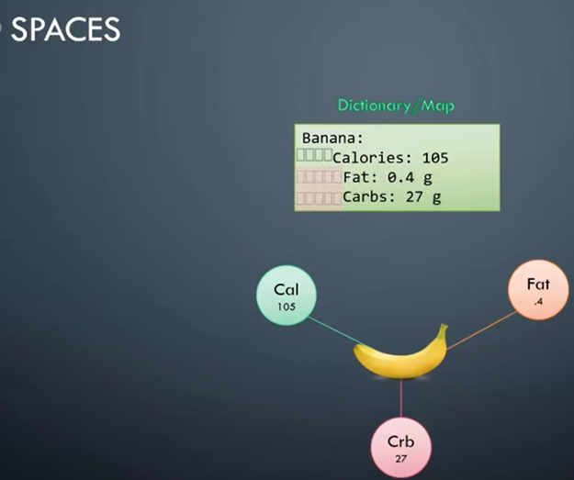
6.4 Yaml Spaces
https://www.youtube.com/watch?v=o9pT9cWzbnI&list=PL2We04F3Y_43dAehLMT5GxJhtk3mJtkl5&index=6
Yaml Spaces (2:47/8:25)
Let’s take a closer look at spaces in Yaml.
Here, we have a dictionary representing the nutrition information of Banana.
The total amount of Calories, Fat, and Carbs are shown.

Slide 15
6.4 Yaml Spaces
https://www.youtube.com/watch?v=o9pT9cWzbnI&list=PL2We04F3Y_43dAehLMT5GxJhtk3mJtkl5&index=6
Yaml Spaces (3:00/8:25)
Notice the number of spaces before each property that indicates these the key-values pairs fall within Banaba.

Slide 16
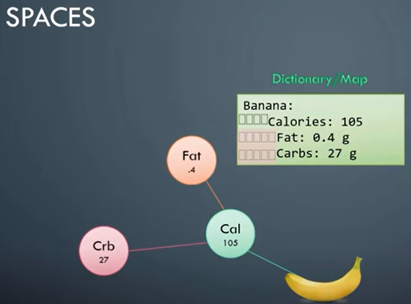
6.4 Yaml Spaces
https://www.youtube.com/watch?v=o9pT9cWzbnI&list=PL2We04F3Y_43dAehLMT5GxJhtk3mJtkl5&index=6
Yaml Spaces (3:08/8:25)
But what if we have extra spaces for Fat and Carbs?
Then they (Fat and Carbs) will fall under Calories and thus Fat and Carbs become properties of Calories which does not make any sense.

Slide 17
6.4 Yaml Spaces
https://www.youtube.com/watch?v=o9pT9cWzbnI&list=PL2We04F3Y_43dAehLMT5GxJhtk3mJtkl5&index=6
Yaml Spaces (3:20/8:25)
This will result in a syntax error which will tell us that mapping values are not allowed here.
…because Calories already have a value set which is 105.

Slide 18
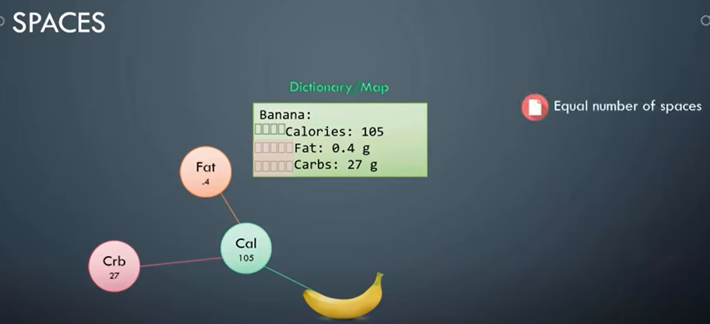
6.4 Yaml Spaces
https://www.youtube.com/watch?v=o9pT9cWzbnI&list=PL2We04F3Y_43dAehLMT5GxJhtk3mJtkl5&index=6
Yaml Spaces (3:26/8:25)
We can either set a direct value or a hash map.
We cannot have both.
So, the number of spaces before each property is key in YMAL.

Slide 19
6.4 Yaml Spaces
https://www.youtube.com/watch?v=o9pT9cWzbnI&list=PL2We04F3Y_43dAehLMT5GxJhtk3mJtkl5&index=6
Yaml Spaces (3:37/8:25)
We must make sure they are in the right form to represent our data correctly.

Slide 20
6.5 Yaml Advanced

Slide 21
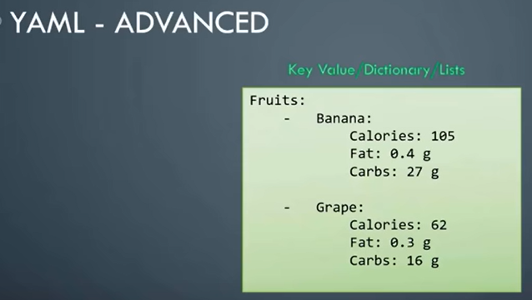
6.5 Yaml Advanced
https://www.youtube.com/watch?v=o9pT9cWzbnI&list=PL2We04F3Y_43dAehLMT5GxJhtk3mJtkl5&index=6
Yaml Advanced (3:45/8:25)
Let’s discuss in another level.
We can have a list containing dictionaries which contain a list.
For example, we have a list of fruits, and the elements of the list are Banana and Grape.

Slide 22
6.5 Yaml Advanced
https://www.youtube.com/watch?v=o9pT9cWzbnI&list=PL2We04F3Y_43dAehLMT5GxJhtk3mJtkl5&index=6
Yaml Advanced (4:00/8:25)
…But each of these element are further dictionaries which contains nutrition information.

Slide 23
6.6 Dictionary, List, List of Dictionaries

Slide 24

6.6 Dictionary, List, List of Dictionaries
https://www.youtube.com/watch?v=o9pT9cWzbnI&list=PL2We04F3Y_43dAehLMT5GxJhtk3mJtkl5&index=6
Dictionary, List, List of Dictionaries (4:08/8:25)
A lot of people are confused about Yaml: When to use a dictionary or a list.
Let’s discuss about Dictionary, List, and List of Dictionaries.
First, let’s understand that all what we discussed so far, such as, XML, JSON, or Yaml are used to represented data.
It can be data about the organization, all its employees, and their personal details.
…Or it can be data about a school, all its students, all their grades.
…Or it can be data about an automobile manufacturing company, all its cars, and its details.
The XML, JSON, and Yaml can be used to represent any data.

Slide 25
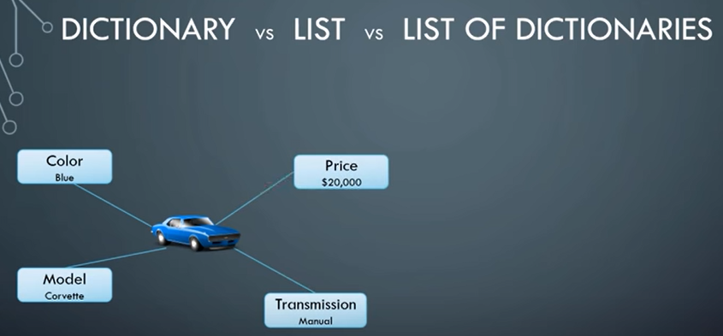
6.6 Dictionary, List, List of Dictionaries
https://www.youtube.com/watch?v=o9pT9cWzbnI&list=PL2We04F3Y_43dAehLMT5GxJhtk3mJtkl5&index=6
Dictionary, List, List of Dictionaries (4:52/8:25)
Let’s take an example of a car.
A car is a single object.
A car has properties, such as, color, model, transition, and price.

Slide 26
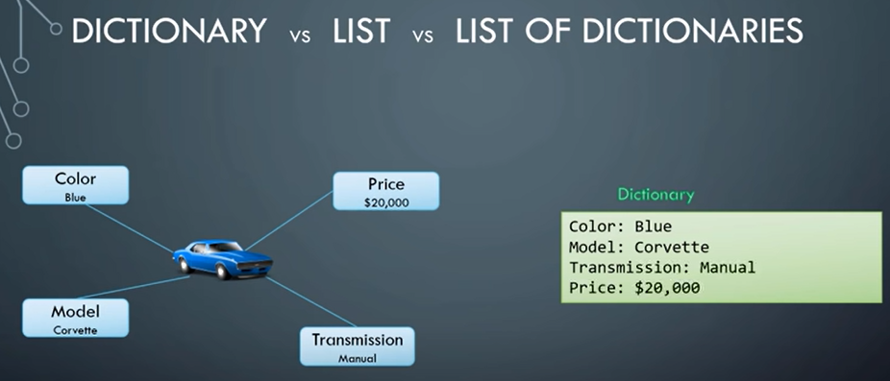
6.6 Dictionary, List, List of Dictionaries
https://www.youtube.com/watch?v=o9pT9cWzbnI&list=PL2We04F3Y_43dAehLMT5GxJhtk3mJtkl5&index=6
Dictionary, List, List of Dictionaries (5:00/8:25)
To store information or properties of a single object, we use a dictionary.
In this simple dictionary, we have properties of the car defined in a key-value format.
The object may not as simple as this.

Slide 27
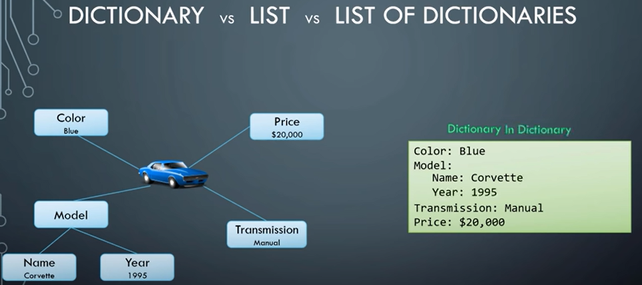
6.6 Dictionary, List, List of Dictionaries
https://www.youtube.com/watch?v=o9pT9cWzbnI&list=PL2We04F3Y_43dAehLMT5GxJhtk3mJtkl5&index=6
Dictionary, List, List of Dictionaries (5:30/8:25)
In this case, the single value of model is now replaced by a small dictatory with two properties name and year.
SO, this is the dictionary within another dictionary.

Slide 28
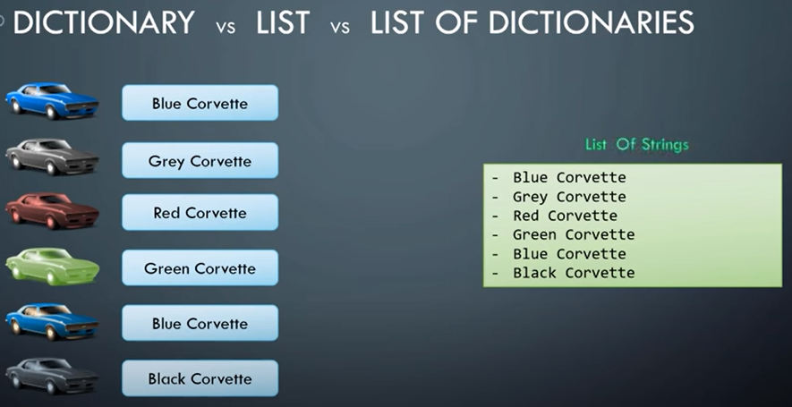
6.6 Dictionary, List, List of Dictionaries
https://www.youtube.com/watch?v=o9pT9cWzbnI&list=PL2We04F3Y_43dAehLMT5GxJhtk3mJtkl5&index=6
Dictionary, List, List of Dictionaries (5:46/8:25)
Let’s say, we would like to store name of six cars.
The names are formed by the color and the model of the car.
To store this, we would use a list or an array, as it is multiple items of the same type of object.
Since we are only storing the names, we have a simple list of strings.

Slide 29
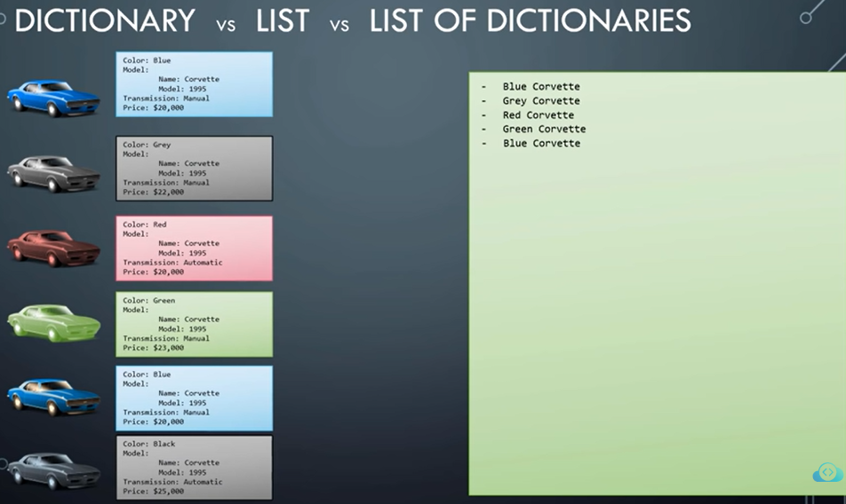
6.6 Dictionary, List, List of Dictionaries
https://www.youtube.com/watch?v=o9pT9cWzbnI&list=PL2We04F3Y_43dAehLMT5GxJhtk3mJtkl5&index=6
Dictionary, List, List of Dictionaries (6:10/8:25)
What is we would like to store all information about each car?
Everything that we listed before, such as, color, model, transition, and price.

Slide 30
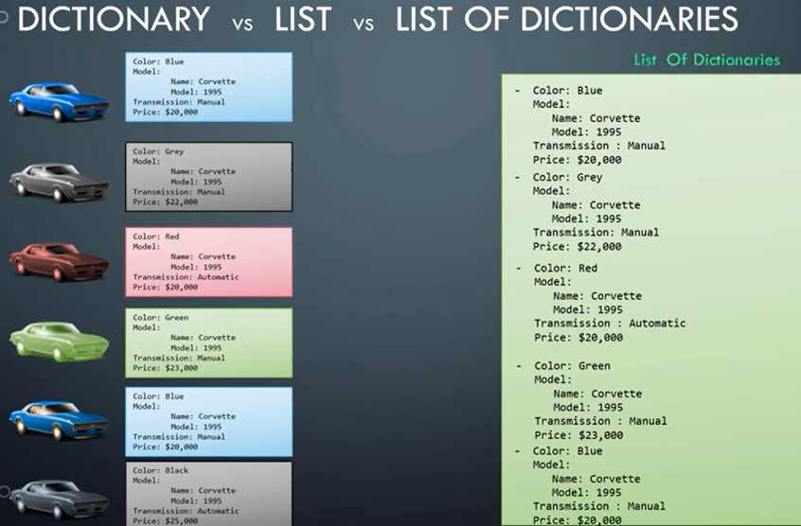
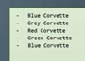
6.6 Dictionary, List, List of Dictionaries
https://www.youtube.com/watch?v=o9pT9cWzbnI&list=PL2We04F3Y_43dAehLMT5GxJhtk3mJtkl5&index=6
Dictionary, List, List of Dictionaries (6:20/8:25)
So, we expand each item in the array and replace the name with the dictionary we built earlier.

Slide 31
6.6 Dictionary, List, List of Dictionaries
https://www.youtube.com/watch?v=o9pT9cWzbnI&list=PL2We04F3Y_43dAehLMT5GxJhtk3mJtkl5&index=6
Dictionary, List, List of Dictionaries (6:51/8:25)
We will then modify the array from a list of strings to a list of dictionaries.

Slide 32
6.6 Dictionary, List, List of Dictionaries
https://www.youtube.com/watch?v=o9pT9cWzbnI&list=PL2We04F3Y_43dAehLMT5GxJhtk3mJtkl5&index=6
Dictionary, List, List of Dictionaries (6:57/8:25)
So, that is the difference between dictionary, list, and list of dictionaries.
We must understand the difference between the three and when to use each of these.

Slide 33
6.7 Yaml Notes

Slide 34
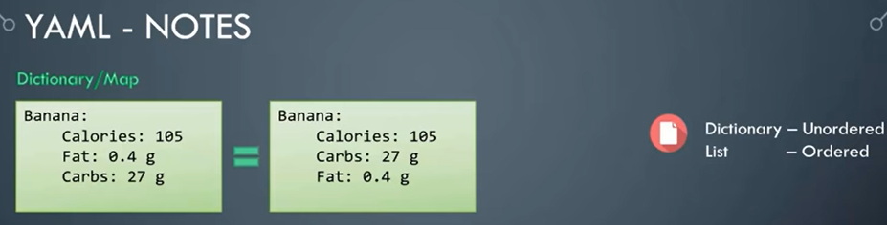
6.7 Yaml Notes
https://www.youtube.com/watch?v=o9pT9cWzbnI&list=PL2We04F3Y_43dAehLMT5GxJhtk3mJtkl5&index=6
Yaml Notes (7:10/8:25)
Here, we discuss some key notes
Dictionary is an unordered collection, whereas lists are ordered collection.
So, what is that mean?
That means, two dictionaries that you see here have the same properties for Banana.

Slide 35
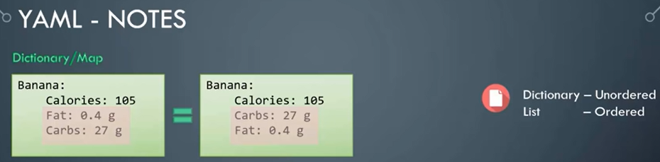
6.7 Yaml Notes
https://www.youtube.com/watch?v=o9pT9cWzbnI&list=PL2We04F3Y_43dAehLMT5GxJhtk3mJtkl5&index=6
Yaml Notes (7:20/8:25)
However, we can see the order of the properties, Fat and Carbs, do not match.
In the first dictionary, Fat is defined before Carbs and in the second dictionary, Carbs comes first followed by Fat.
But that does not really matter, the properties can be defined in any order.
But the two dictionaries will still be the same.
As long as the values of each property match.

Slide 36
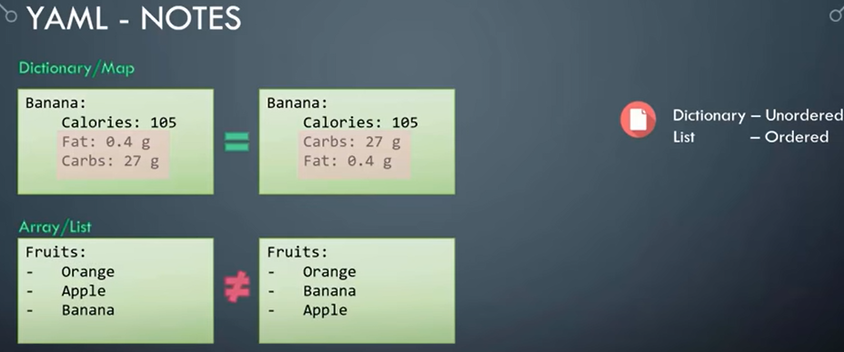
6.7 Yaml Notes
https://www.youtube.com/watch?v=o9pT9cWzbnI&list=PL2We04F3Y_43dAehLMT5GxJhtk3mJtkl5&index=6
Yaml Notes (7:48/8:25)
This is not the same for lists or arrays.
Arrays are ordered collection.
So, the order of items matter.
The two lists shown are not the same because Apple and Banana are at different positions.

Slide 37
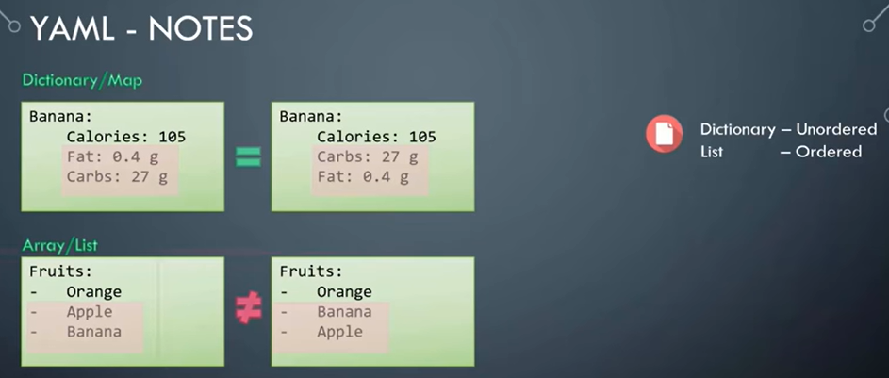
6.7 Yaml Notes
https://www.youtube.com/watch?v=o9pT9cWzbnI&list=PL2We04F3Y_43dAehLMT5GxJhtk3mJtkl5&index=6
Yaml Notes (8:03/8:25)
This is something to keep in mind while working with data structure.

Slide 38
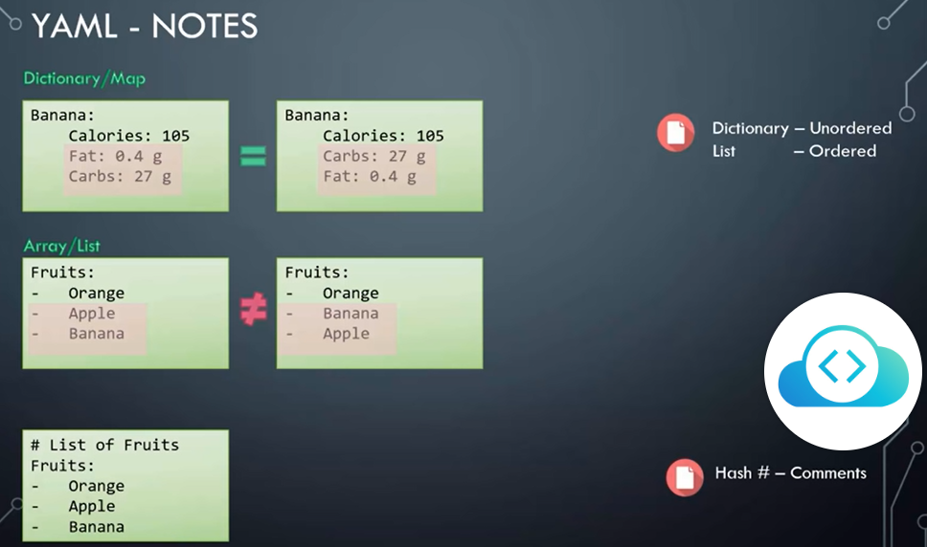
6.7 Yaml Notes
https://www.youtube.com/watch?v=o9pT9cWzbnI&list=PL2We04F3Y_43dAehLMT5GxJhtk3mJtkl5&index=6
Yaml Notes (8:09/8:25)
Also remember, any line beginning with a hash is automatically ignored and is considered as a comment.

Slide 39

6.7 Yaml Notes
https://www.youtube.com/watch?v=o9pT9cWzbnI&list=PL2We04F3Y_43dAehLMT5GxJhtk3mJtkl5&index=6
Yaml Notes (8:20/8:25)
We are now ready to have the coding exercise with Yaml files.

Slide 40
End

